Slide 1


Capstone Project - I
EDA –Play Store app
Review analysis
By – Reetika Srivastava

Slide 2






WHY ANALYZE THE GOOGLE PLAYSTORE?
Mobile App Market is set to grow 20% by 2023
Android Apps
comprise 90% of the
Mobile App Market
What makes an App popular? Can we predict how popular it’s going to be?
What are some
interesting patterns in
user behavior related to
app usage & feedback

Slide 3

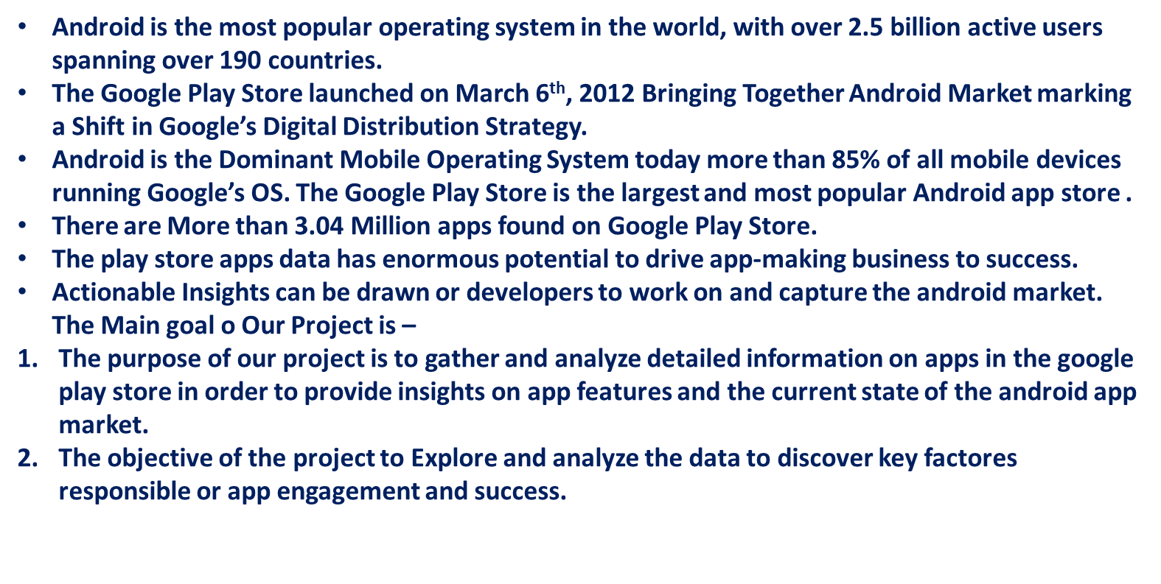

Introduction

Slide 4
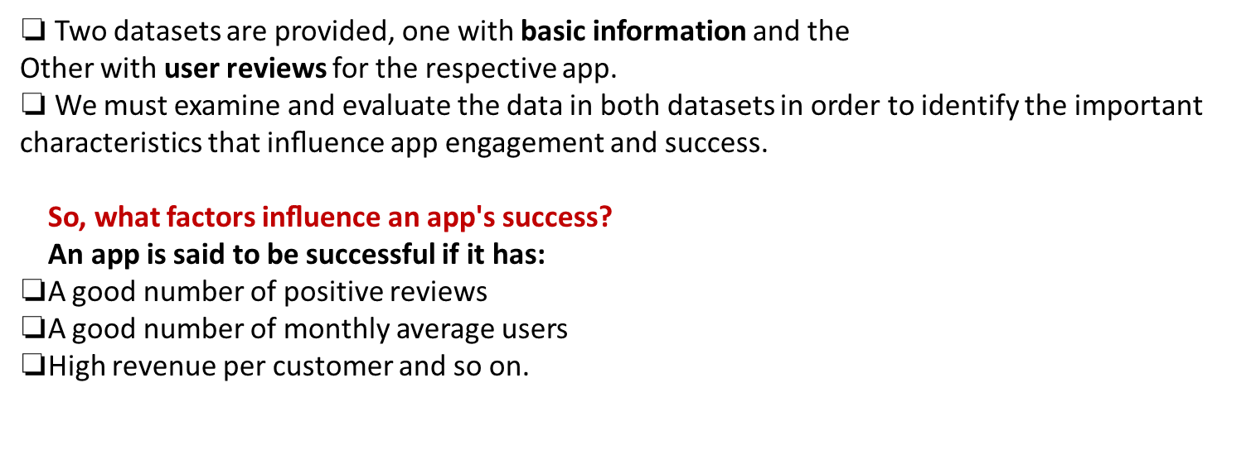


Problem Statement

Slide 5

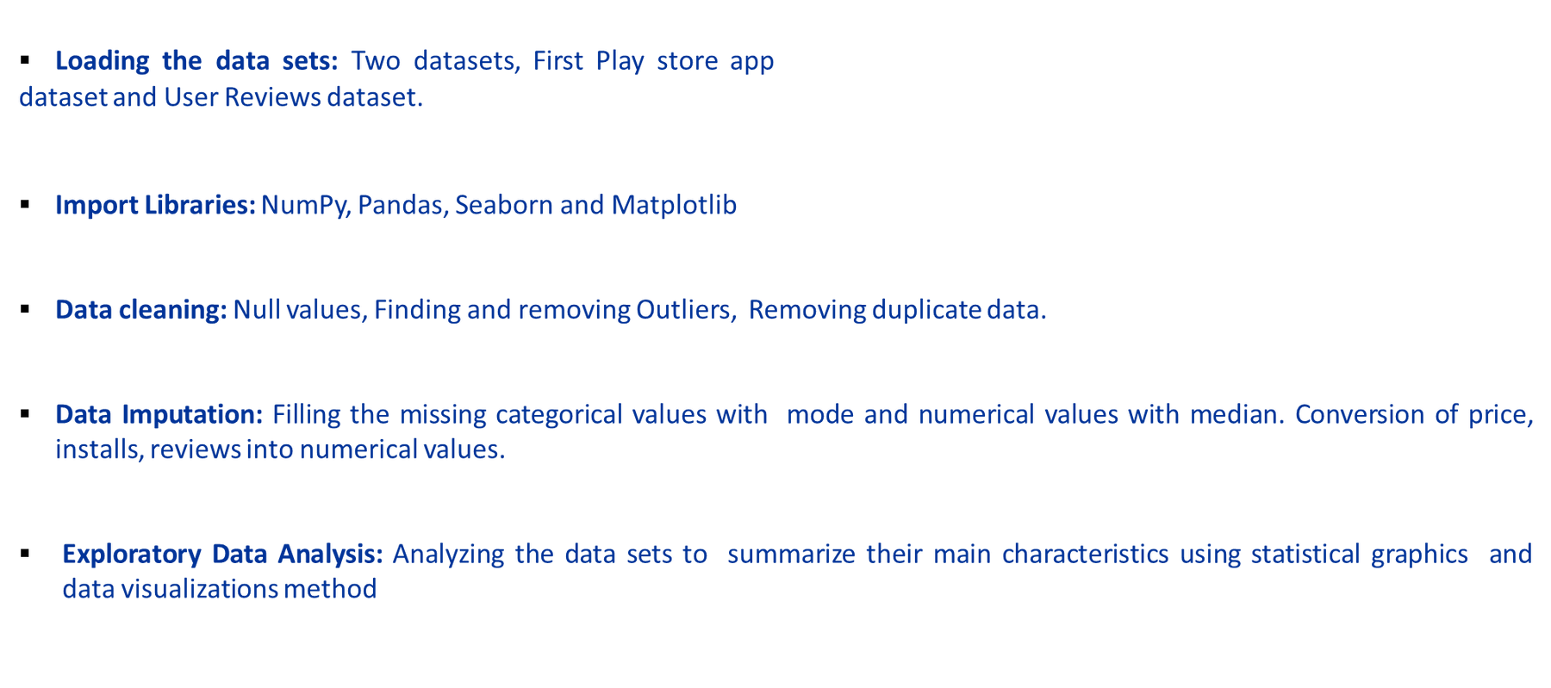

Dataset Preparation

Slide 6
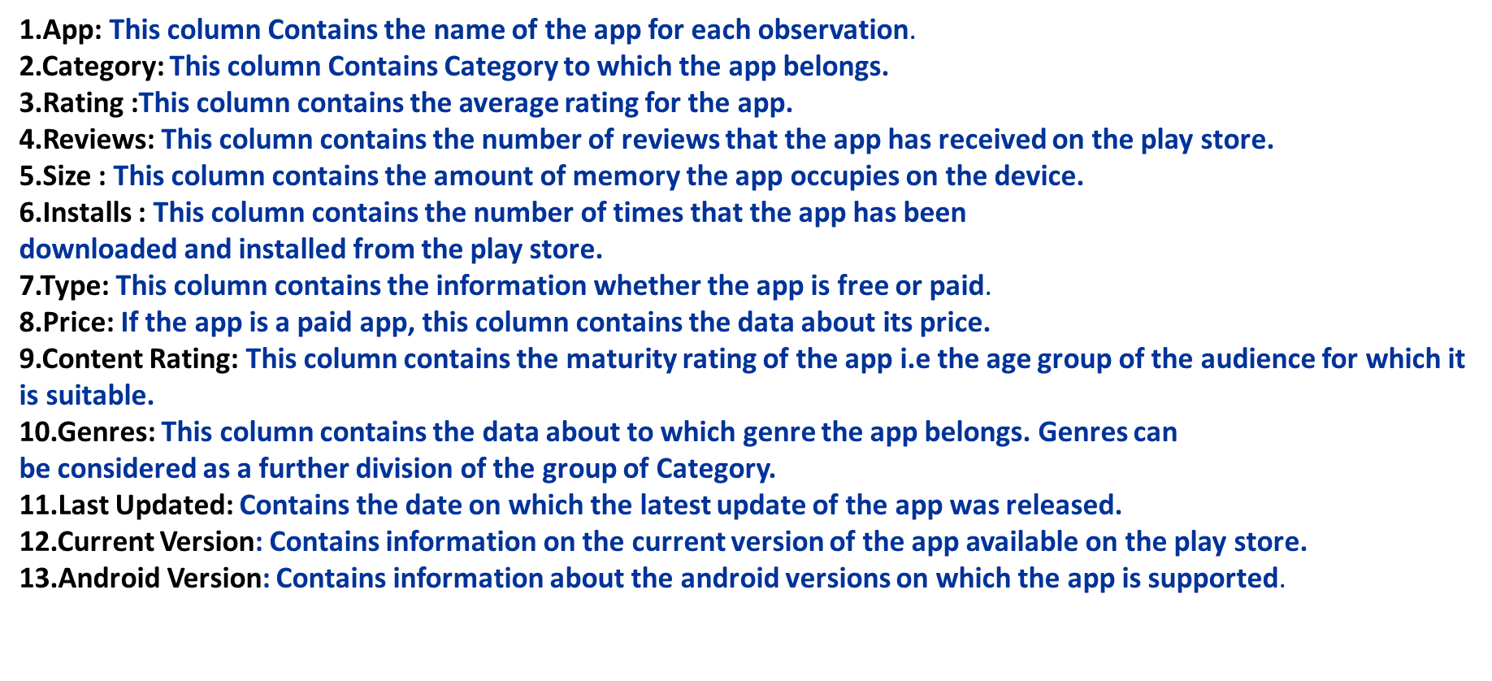
Attributes in Google Play store Data

Slide 7
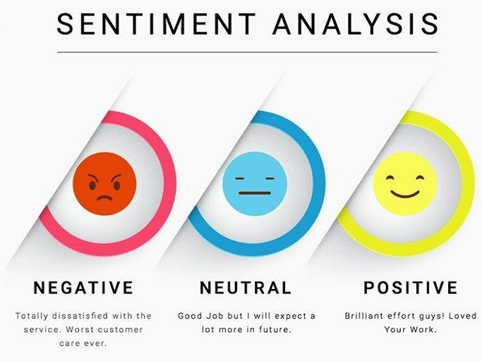

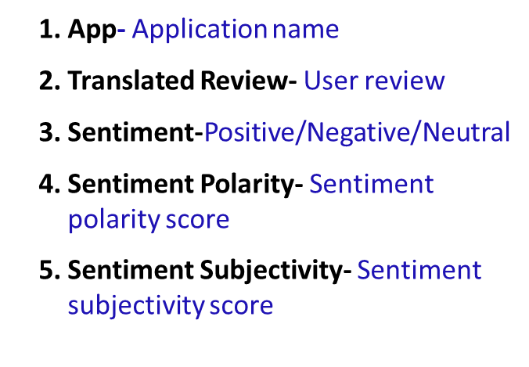

Attributes in User reviews

Slide 8







Data Cleaning
Data Exploration
Predictive Modeling
Understand the structure of the dataset and clean data before analysis
Uncover initial patterns, characteristics, and points of interest using visual exploration
Formulate a statistical model to forecast an outcome using relevant predictors

Slide 9

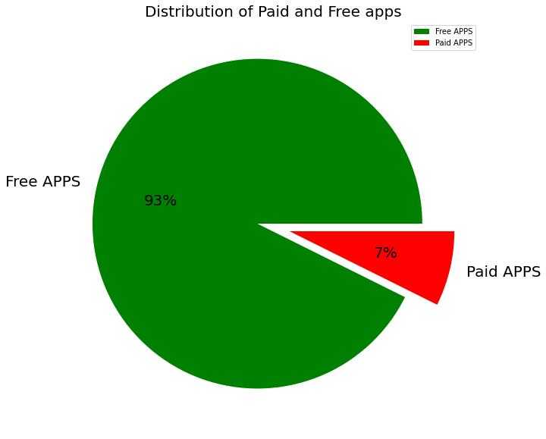

Percentage of Paid apps v/s Free apps
We Observed that 93.00% of Apps are free and only 7.00% of Apps are paid in Play store.

Slide 10
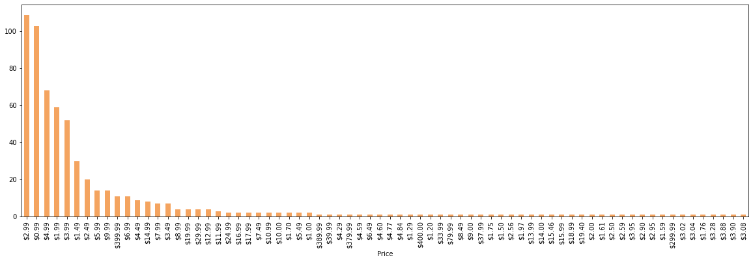
(PAID APPS)
Number of apps that can be installed at a particular price

Slide 11
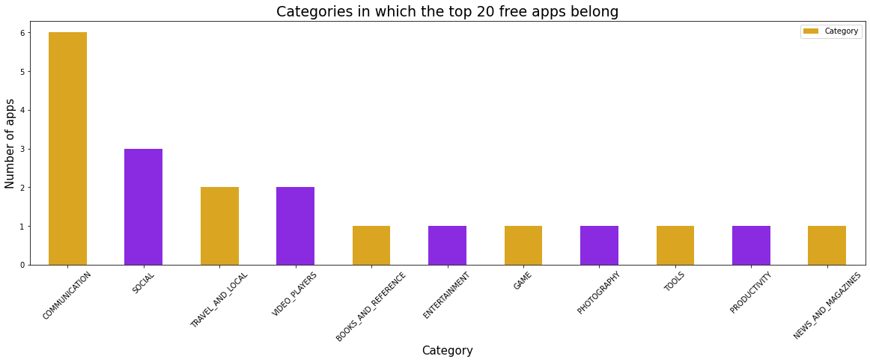
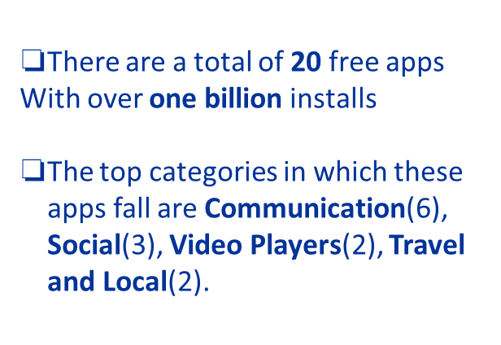
Top app that are of free type

Slide 12
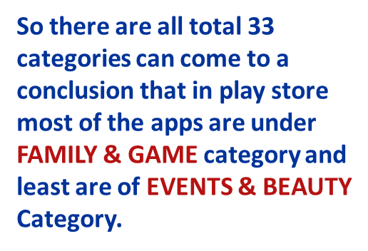
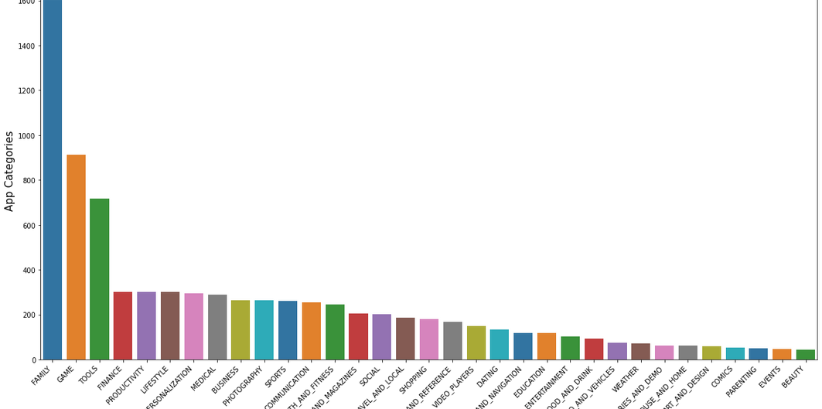
Top categories on google play store

Slide 13
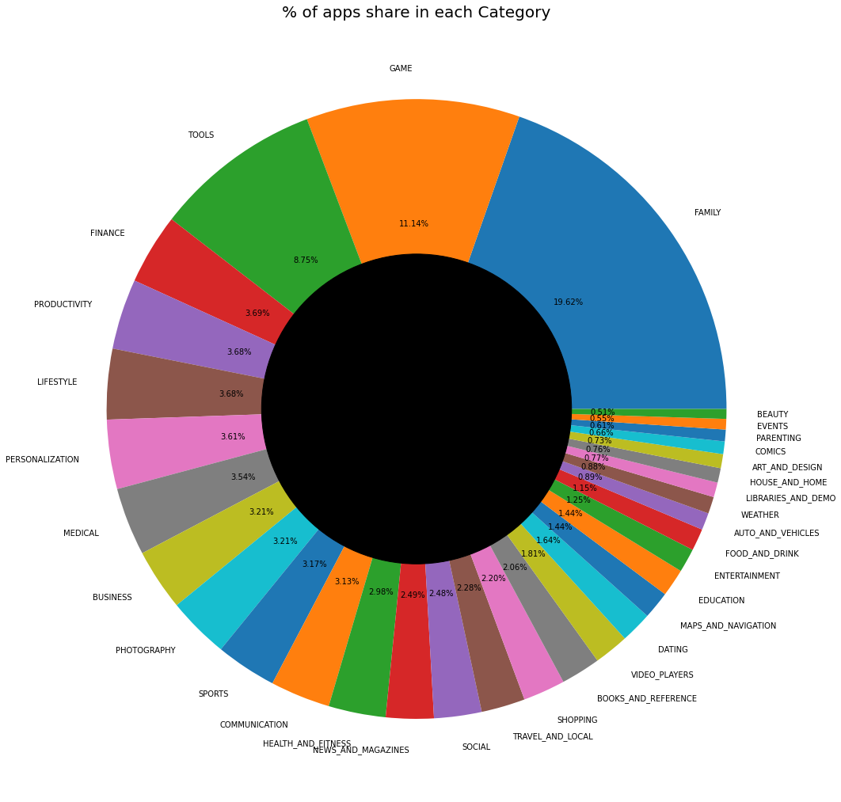

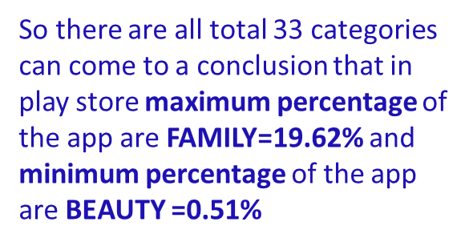
Percentage of apps belonging to each category in the playstore

Slide 14
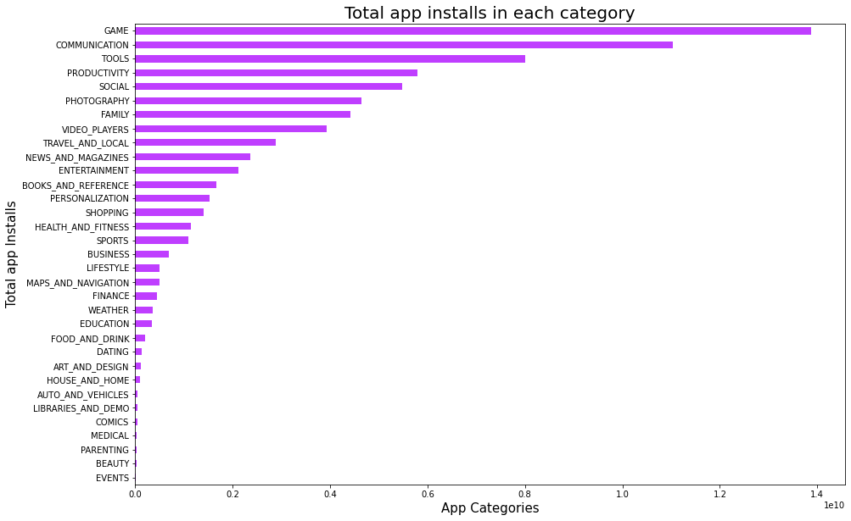
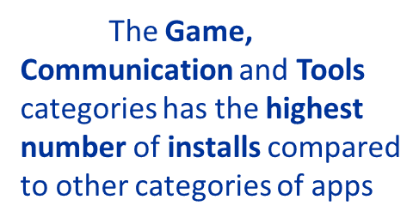
Which category aap's most number of install

Slide 15
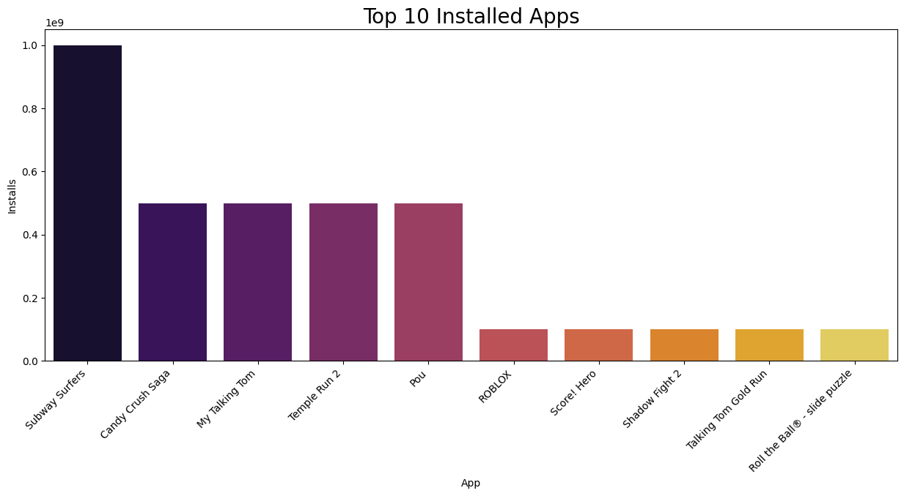
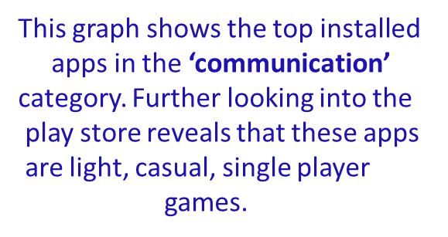
What are the top-10 installed
apps in any categories?
Top 10 App in
Communication Category

Slide 16
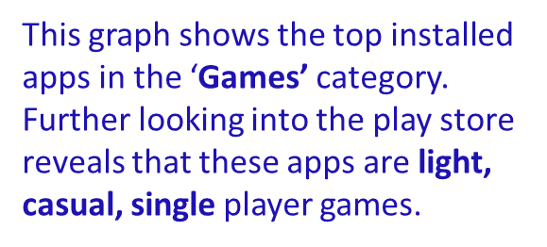
What are the top-10 installed
appsin any categories?
Top 10 App in
Communication Category

Slide 17
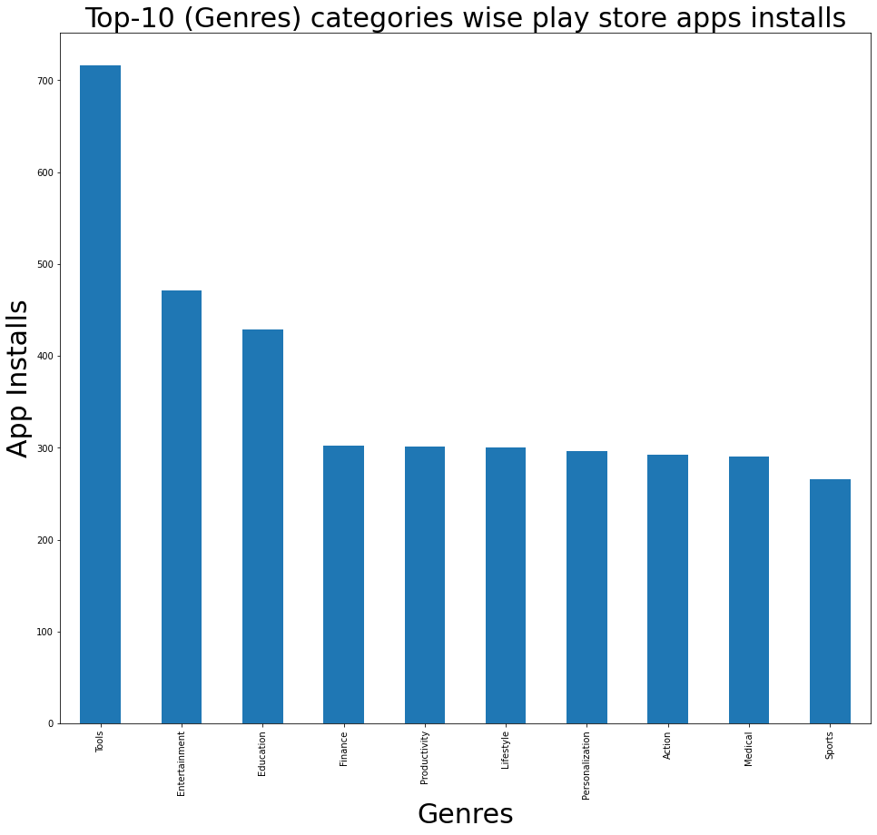
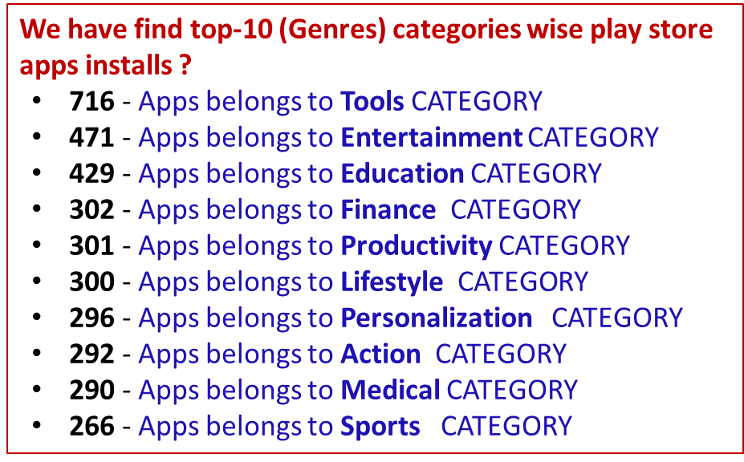
Find top-10 (Genres) categories
wise play store apps installs ?

Slide 18
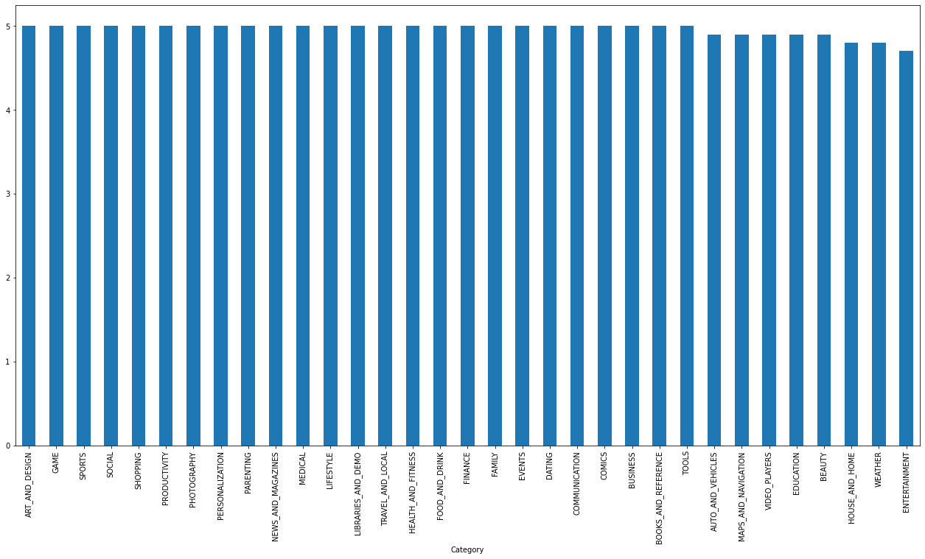
WHICH CATEGORY(GENRES) HAS THE
HIGHEST RATING ON
THE PLAY STORE APP?

Slide 19
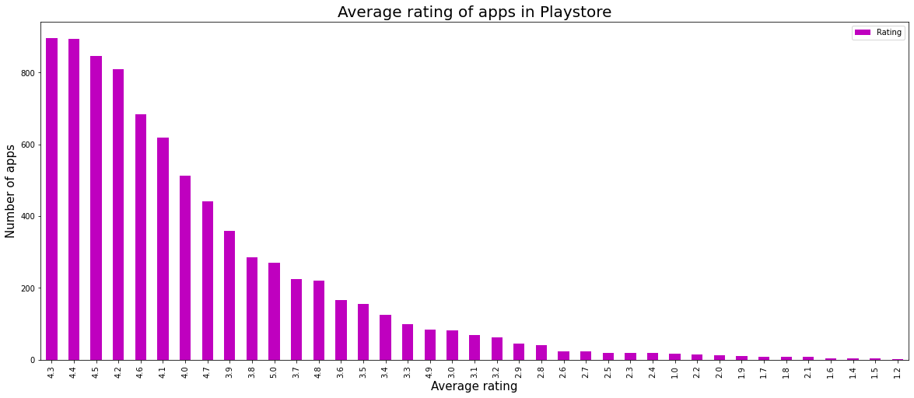
Average rating on the app

Slide 20
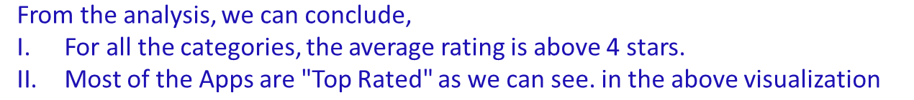
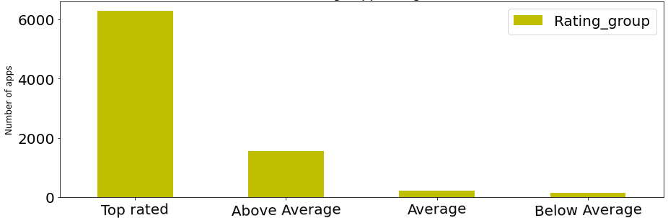
Average app ratings depend
on group rating

Slide 21
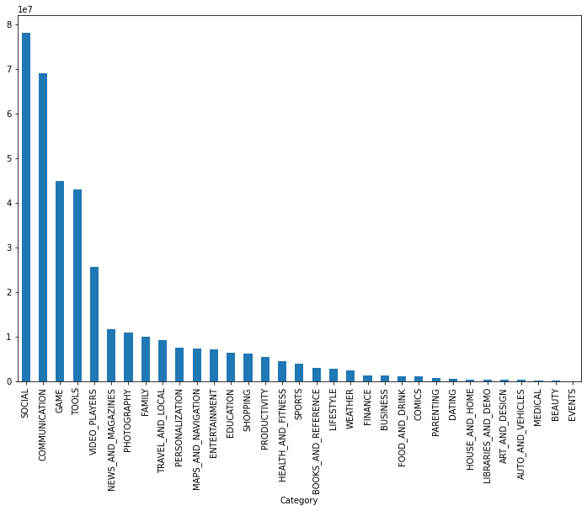
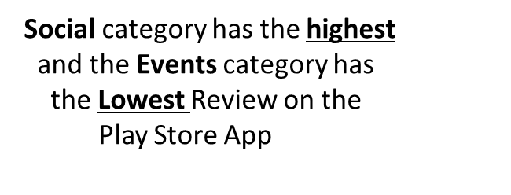
WHICH CATEGORY(GENRES) HAS THE
HIGHEST REVIEW ON THE PLAY STORE APP?

Slide 22
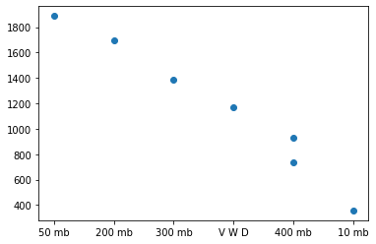
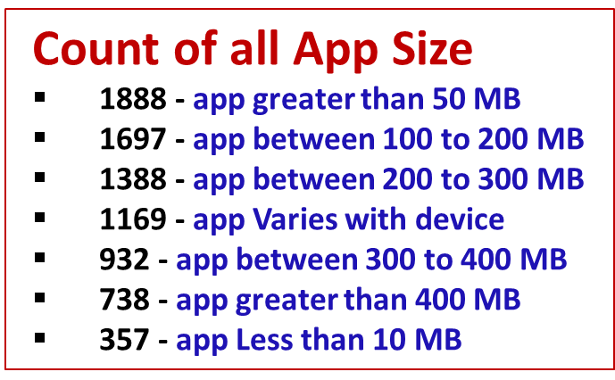
Find the count of all app size

Slide 23
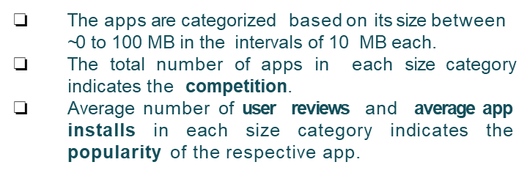
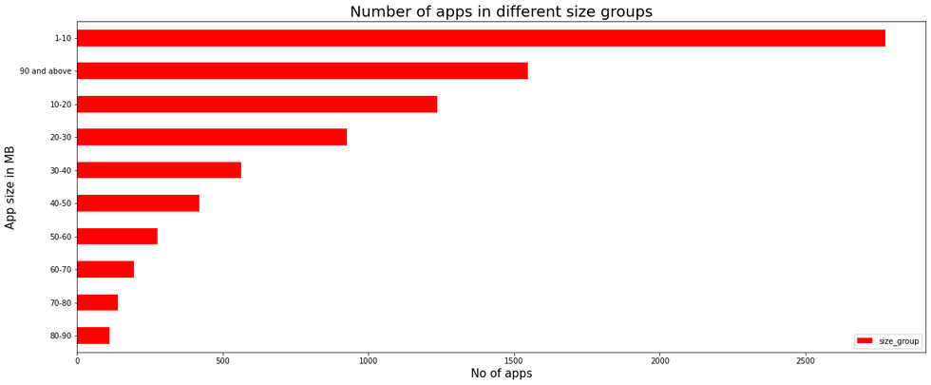
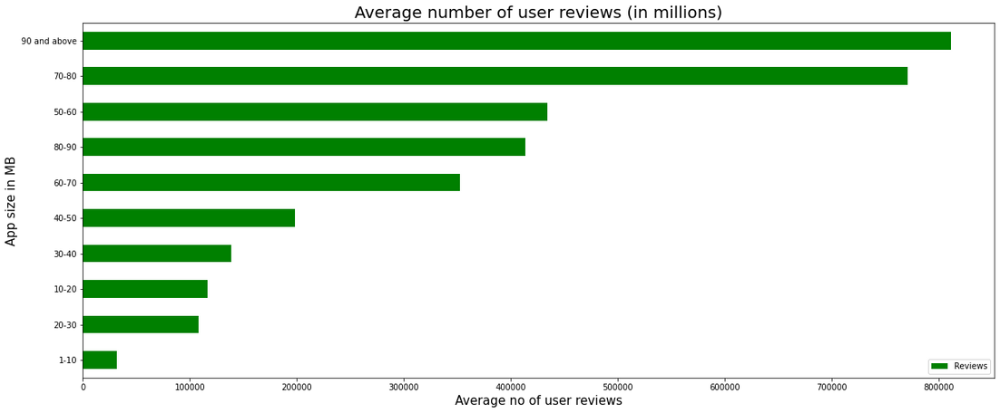
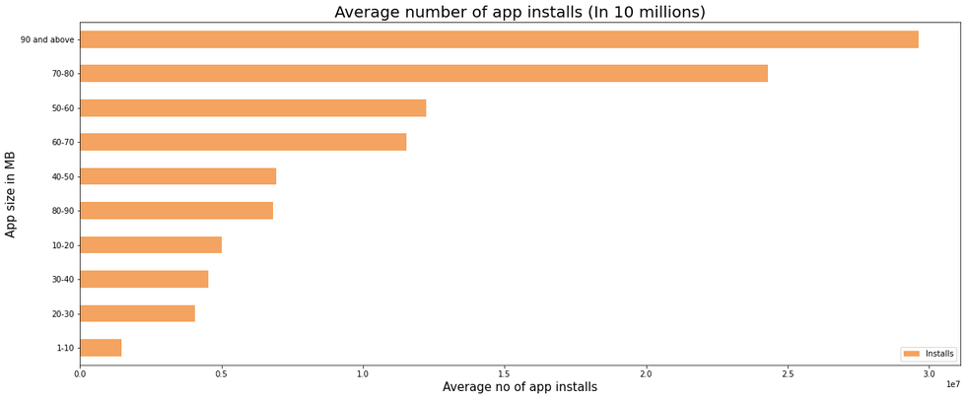
Distribution of app based on its size

Slide 24
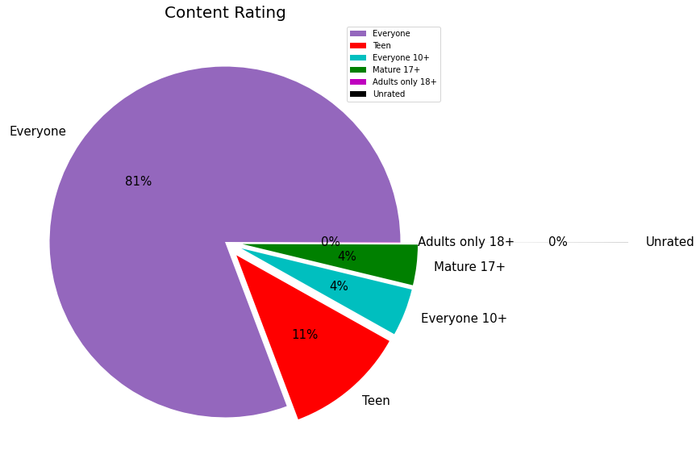
Find out the CONTENT RATING
based all apps availabe on Playstore ?
From the above plot we can see that Everyone category having majority of apps count.
A majority of the apps (81.00%) in the play store are can be used by everyone. The remaining apps have various age restrictions to use it.

Slide 25
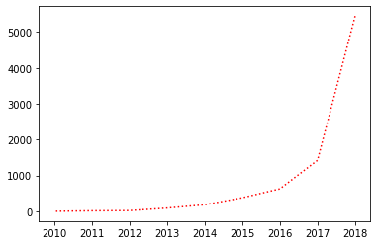
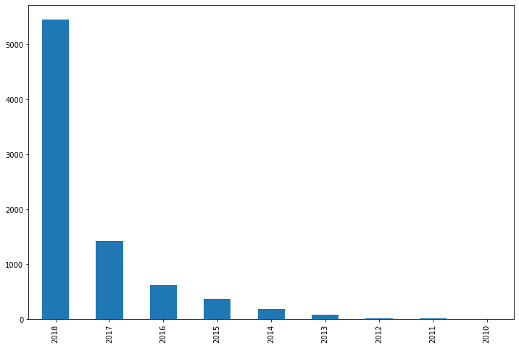
Find out how many app are updated every year

Slide 26
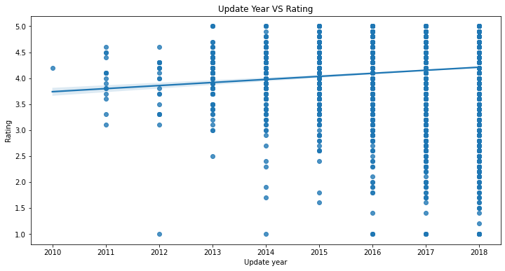
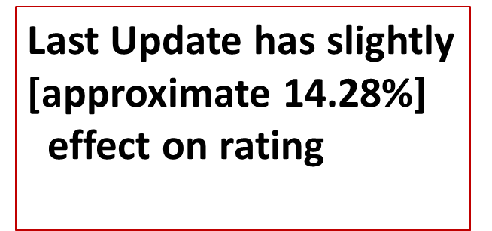
Does last update have affect on rating

Slide 27
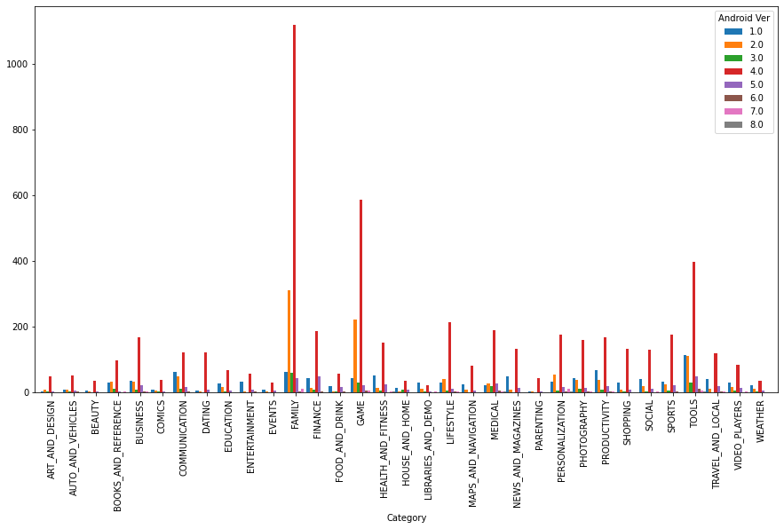

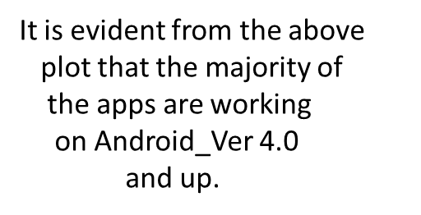
Android version based on each category

Slide 28
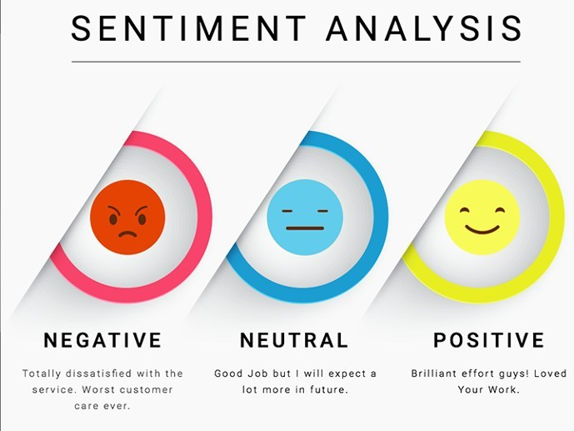

Slide 29
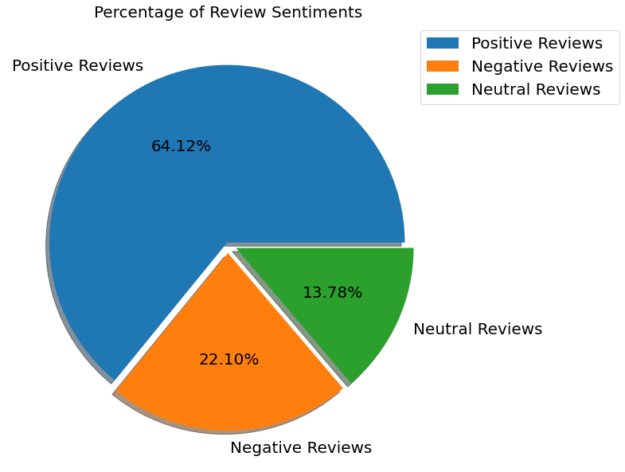
FIND THE PERCENTAGE OF +VE, -VE AND NEUTRAL
REVIEWS IN THE SENTIMENT COLUMN ?
Positive reviews are 64.12%
Negative reviews are 22.10%
Neutral reviews are
13.78%

Slide 30
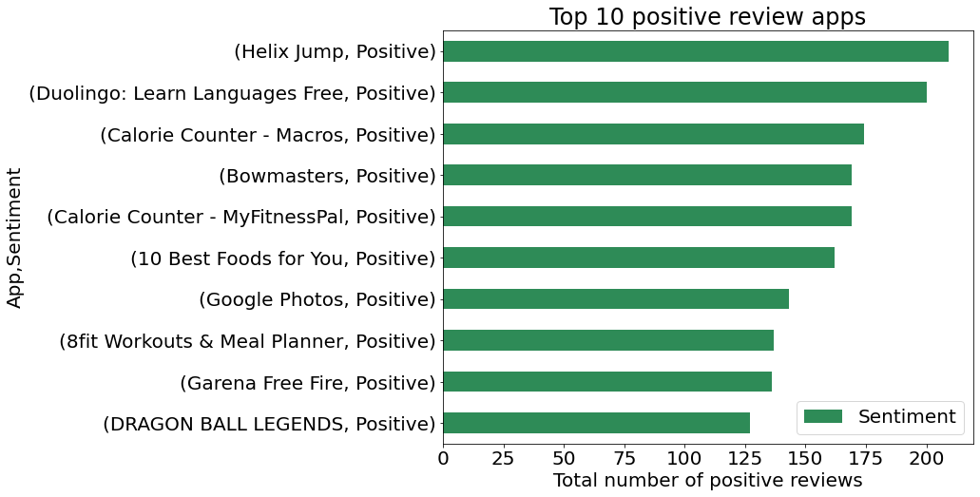
Apps with the highest number of positive reviews

Slide 31
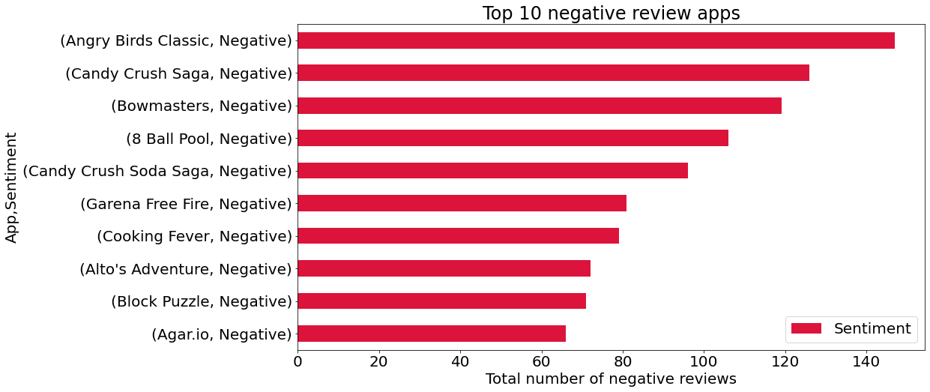
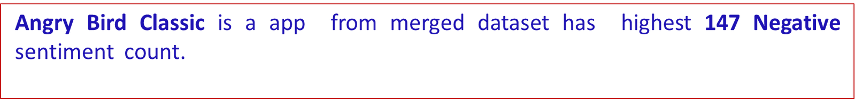
Apps with the highest number of
negative reviews.

Slide 32
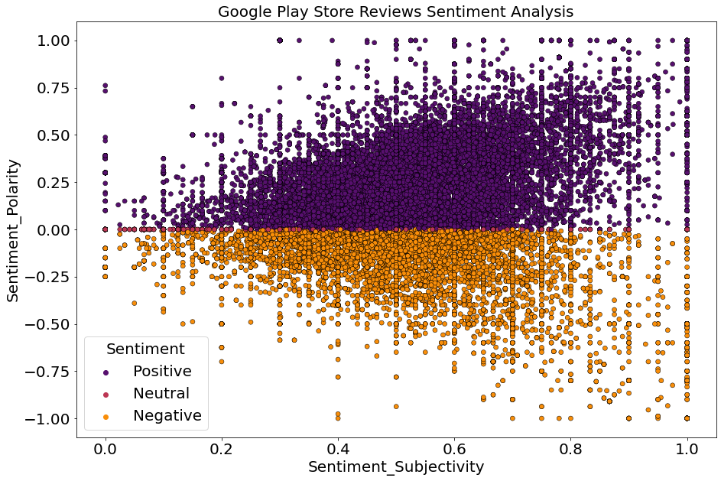
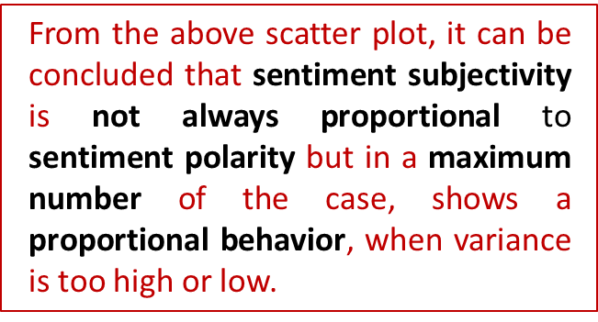
sentiment polarity propotional to
sentiment subjectivity?

Slide 33
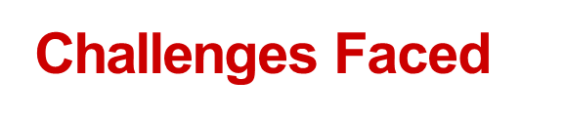
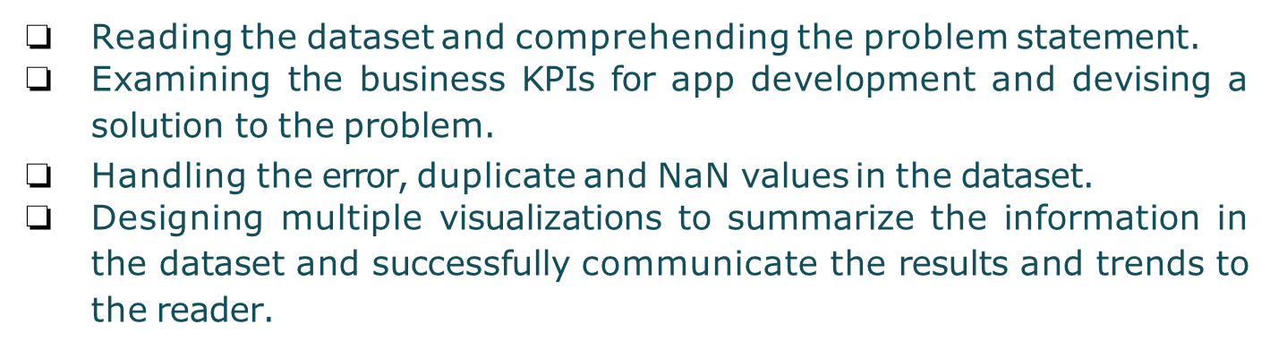


Slide 34
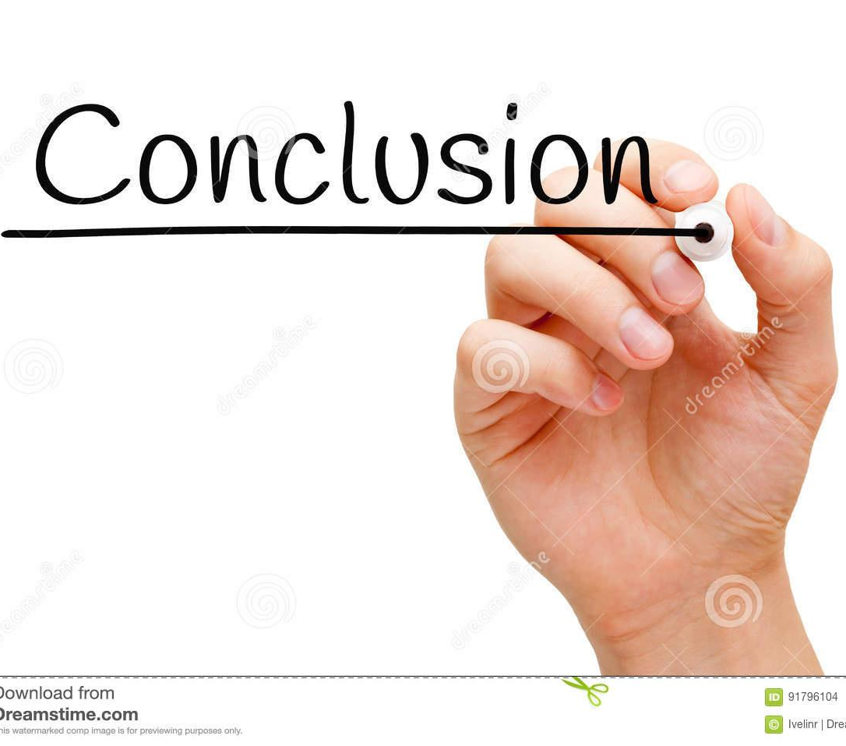


Slide 35


Slide 36
Thank you

